Slide 1
GDP Group 4

Slide 2
Codeword Generator
Client:
Dr. Charles Hoot Jr.
Advisor:
Dr. Nathan Eloe
Team members:
Mallikarjuna Bodepudi
Durga Prasad Vinukonda
Sneha Madhavaram
Swathi Challagundla
Vamshi Krishna Nuka

Slide 3
Contents
Sign up Functional Requirements and its UI sketches.
Log in Functional Requirements and its UI sketches.
Student Functional Requirements and its UI sketches.
Instructor Functional Requirements and its UI sketches.
Admin Functional Requirements and its UI sketches.
Sneha Madhavaram

Slide 4
Sign Up Functional Requirements
The system SHALL allow the students to sign up.
The system SHALL allow an instructor to sign up.
The system SHALL not allow duplicate email ids which are already used to signup.
The system SHALL allow students to enter Email Id and password.
Sneha Madhavaram

Slide 5
Sign Up Functional Requirements
The system SHALL allow an instructor to enter Email Id and password.
The system SHALL accept the login credentials of students, instructors and admin.
The system SHALL send the verification link to the email address which is provided while sign up.
The system SHALL store the credentials to the database.
Sneha Madhavaram

Slide 6
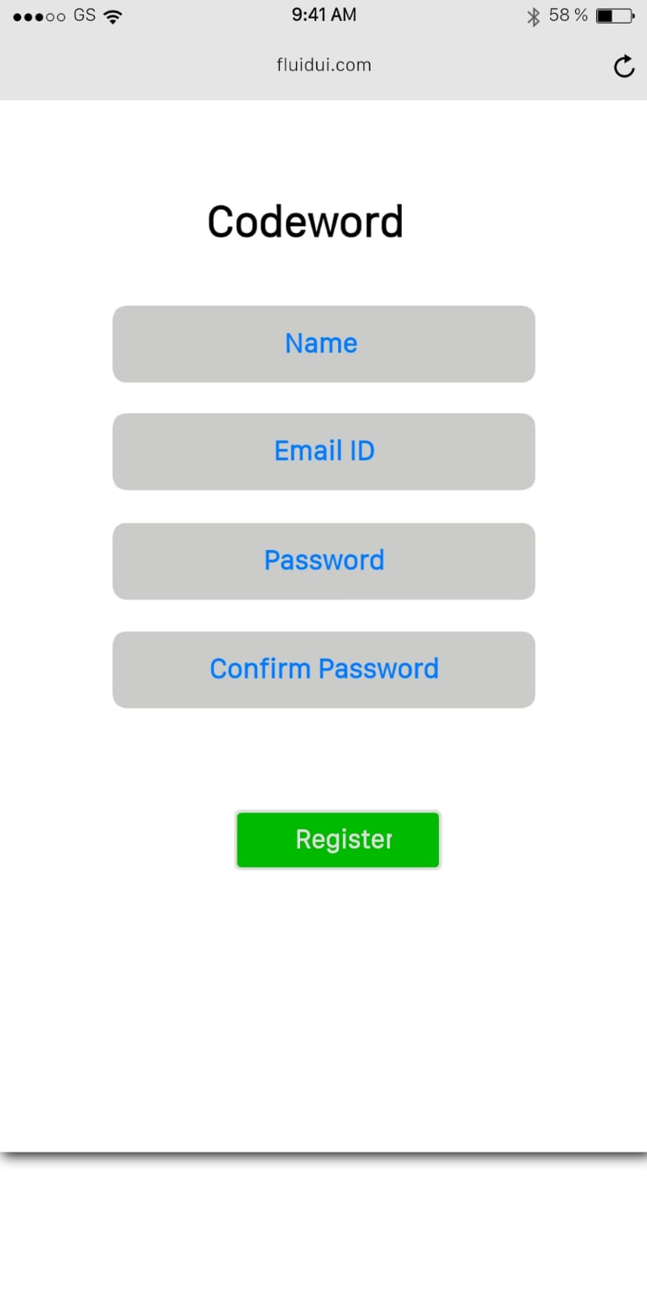
Sneha Madhavaram

Slide 7
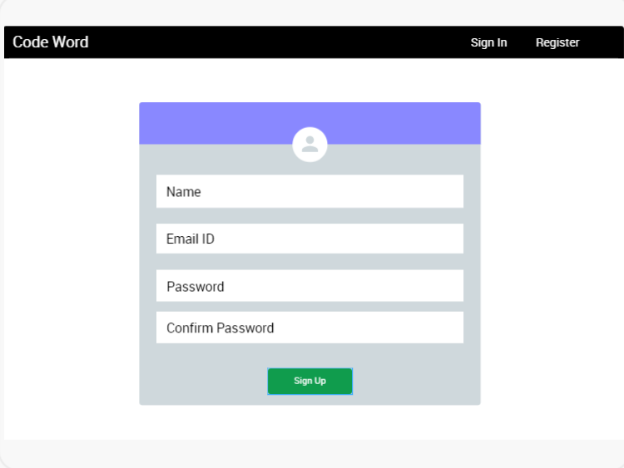
Sneha Madhavaram

Slide 8
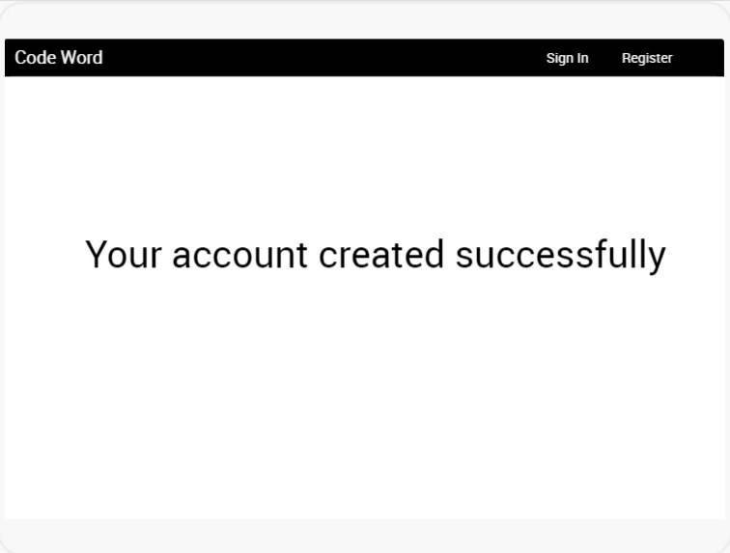
Sneha Madhavaram

Slide 9
Login Functional Requirements
The system SHALL allow the student or instructor or admin to login.
The system SHALL validate the credentials using the credentials stored in database.
The system SHALL redirect to the respective homepage based on the user.
The system SHALL show an error message if user enter invalid credentials.
Sneha Madhavaram

Slide 10
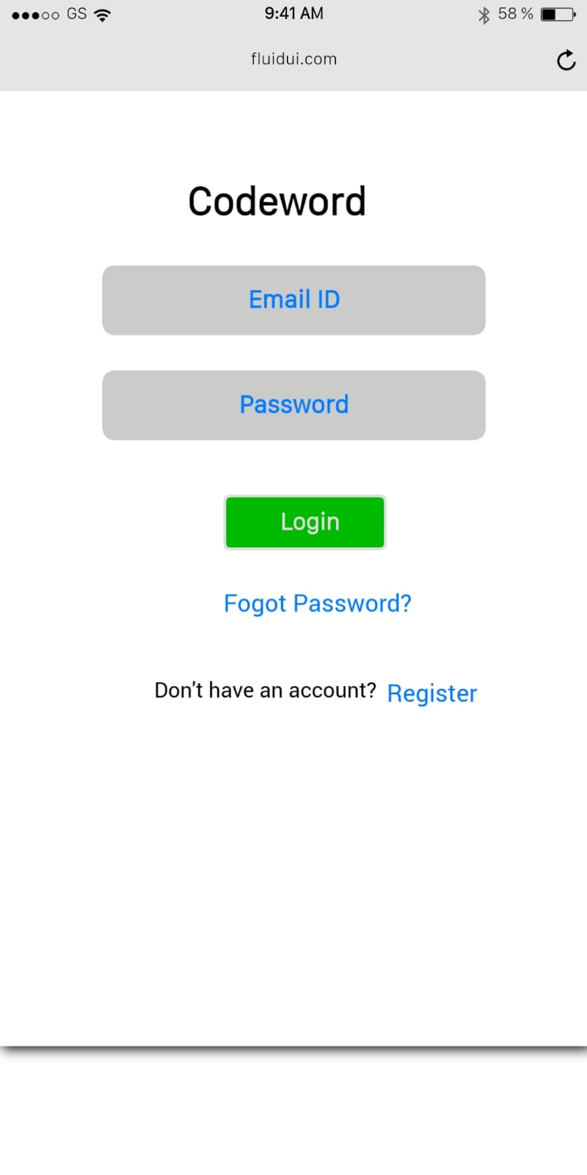
Sneha Madhavaram

Slide 11
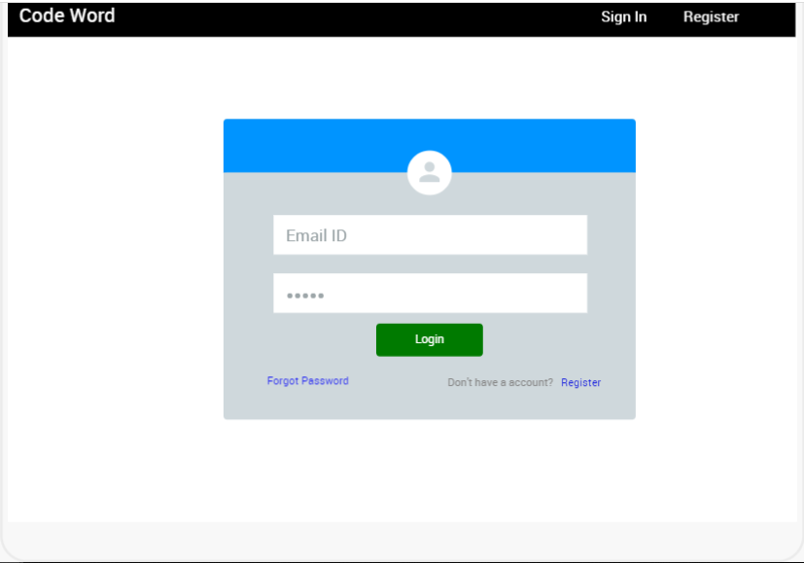
Sneha Madhavaram

Slide 12
Login Functional Requirements
The system SHALL provide forgot password option to set a new password.
The system SHALL allow the user to enter Email Id when the user clicks on forgot password.
Sneha Madhavaram

Slide 13
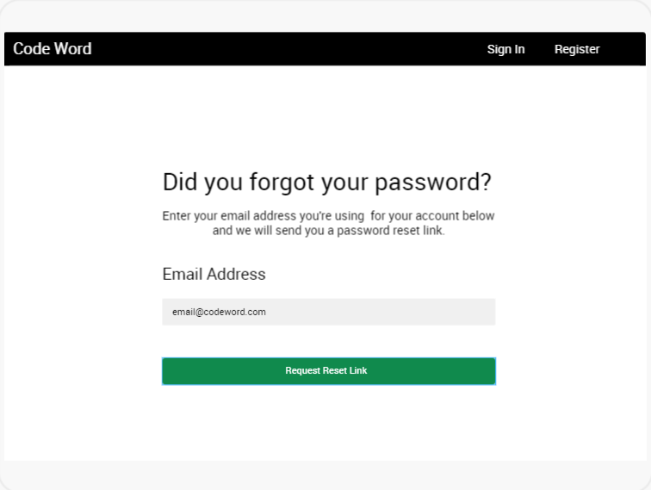
Sneha Madhavaram

Slide 14
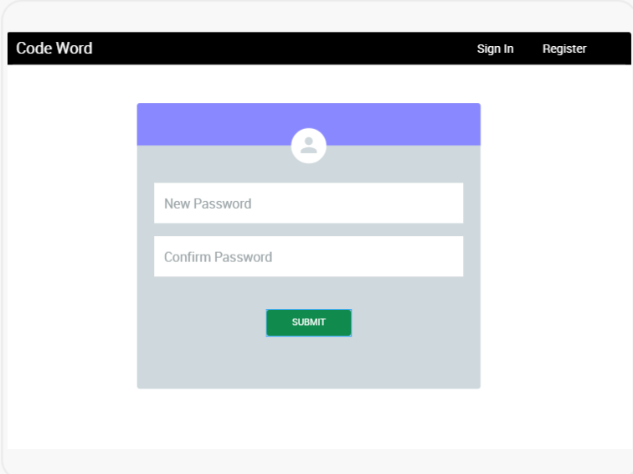
Sneha Madhavaram

Slide 15
Student Functional Requirements
The system SHALL allow the students to see the completed courses with the respective codewords.
The system SHALL allow the students to view the list of current enrolled courses.
The system allow the student to get a codeword from the student dashboard for current courses.
Mallikarjun Bodepudi

Slide 16
Student Functional Requirements
The system SHALL allow a student to apply for instructor privileges.
The system SHALL send feedback to the instructor when they click on 'codeword' button.
The system SHALL allow the student to log out.
Mallikarjun Bodepudi

Slide 17
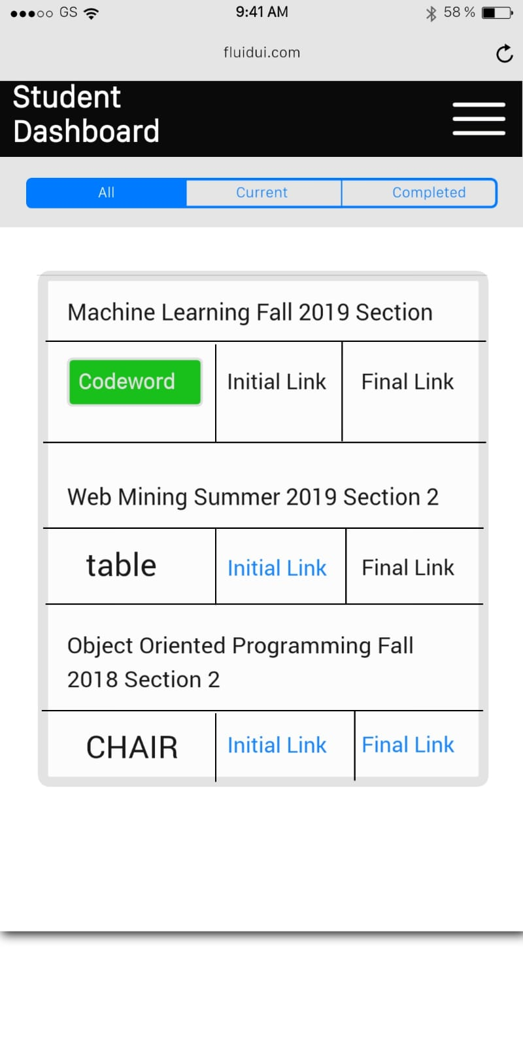
Mallikarjun Bodepudi

Slide 18
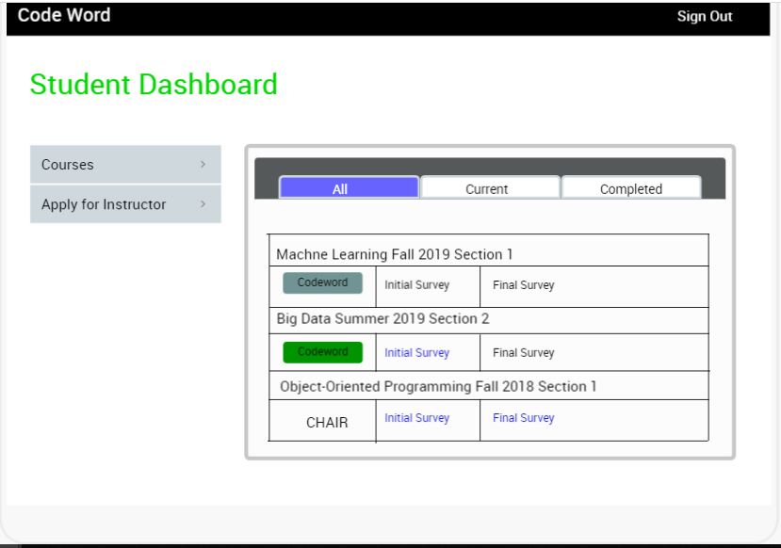
Mallikarjun Bodepudi

Slide 19
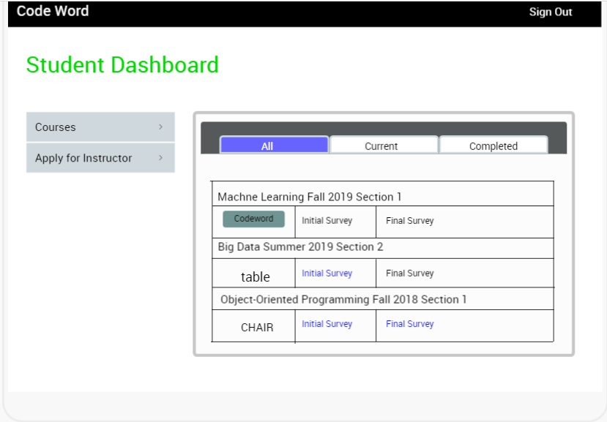
Mallikarjun Bodepudi

Slide 20
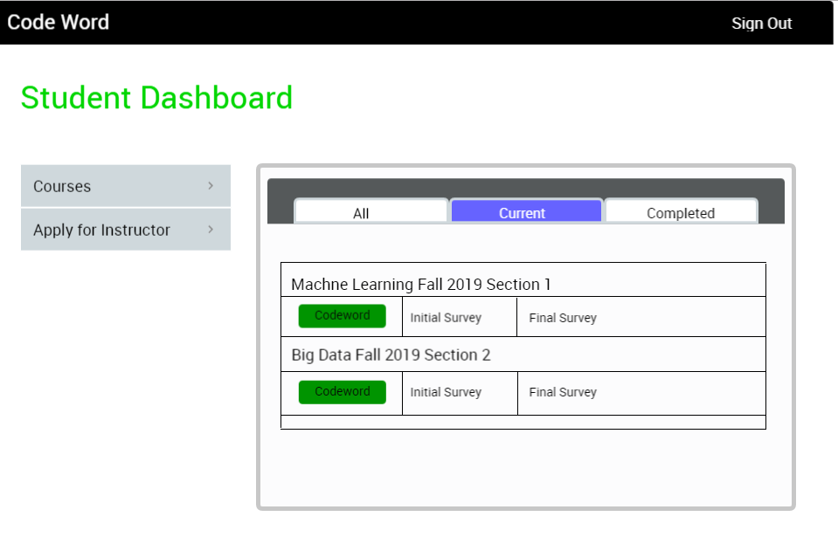
Mallikarjun Bodepudi

Slide 21
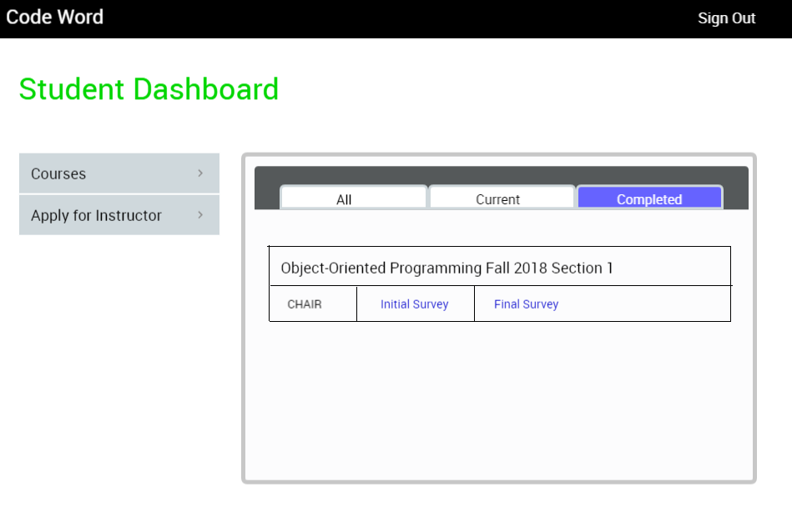
Mallikarjun Bodepudi

Slide 22
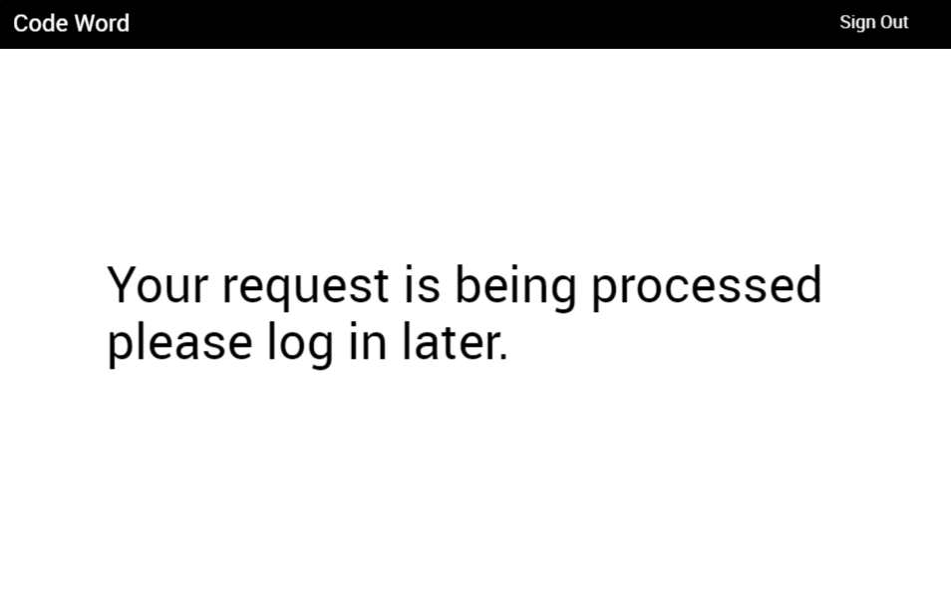
Mallikarjun Bodepudi

Slide 23
Instructor Functional Requirements
The system SHALL allow the instructor to view the courses.
The system SHALL allow the instructor viewing the ratio of students who acknowledged codewords.
The system SHALL allow the instructor to create a new course in the dashboard.
The system SHALL allow the instructor to provide the list of students while course creation.
Swathi Challagundla

Slide 24
Instructor Functional Requirements
The system SHALL allow the instructor to give the course name while course creation.
The system SHALL allow the instructor to provide initial and final survey links for the course.
The system SHALL allow the instructor to select the codeword set name while course creation.
The system SHALL allow the instructor to delete an existing course in the dashboard.
Swathi Challagundla

Slide 25
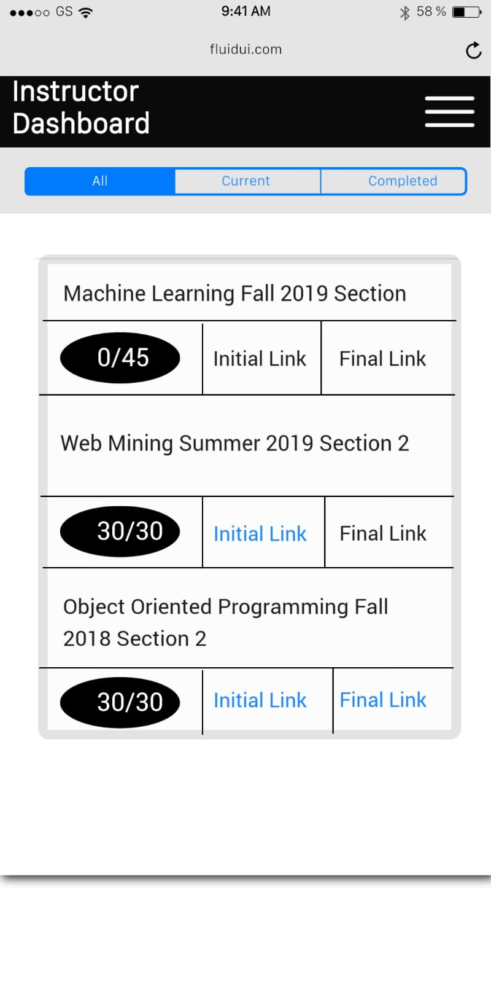
Swathi Challagundla

Slide 26
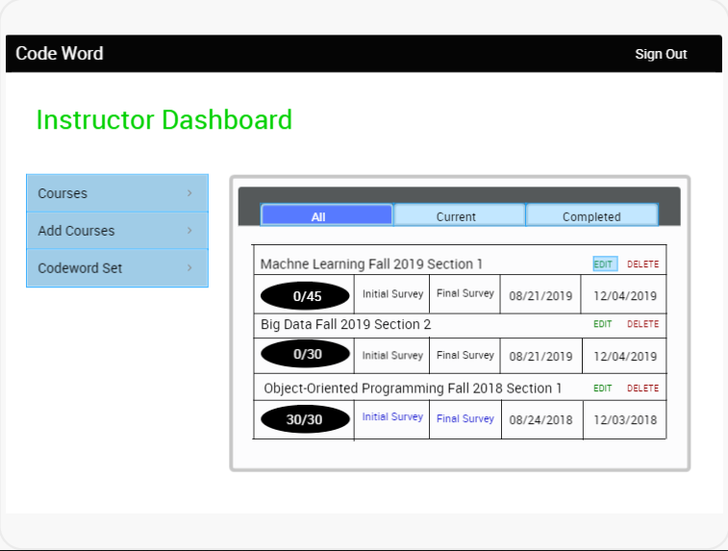
Swathi Challagundla

Slide 27
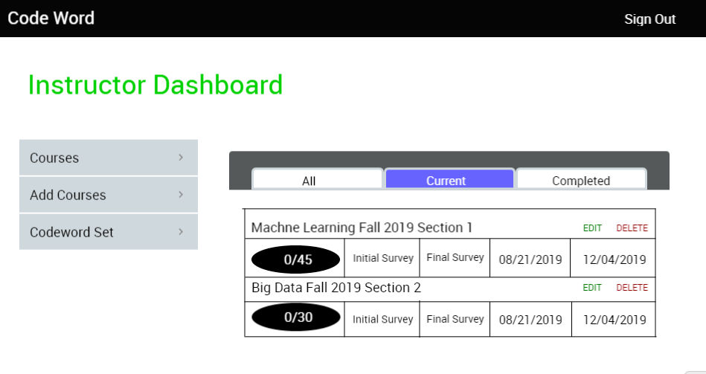
Swathi Challagundla

Slide 28
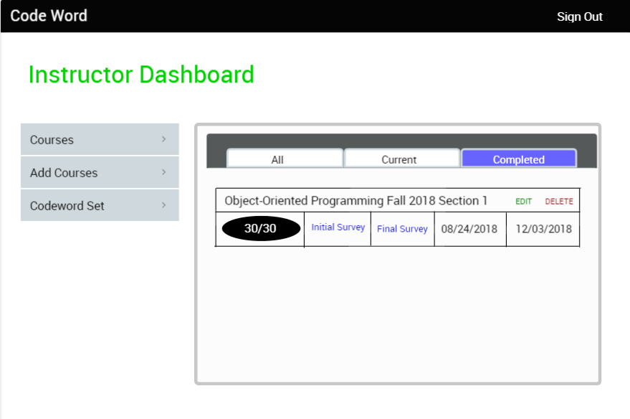
Swathi Challagundla

Slide 29
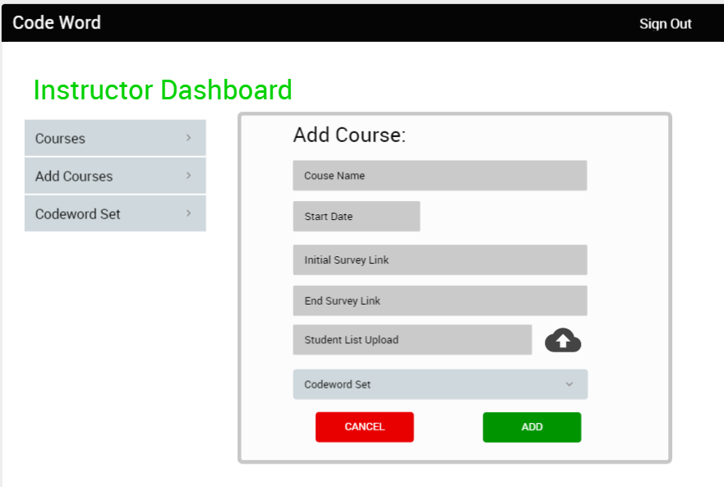
Swathi Challagundla
Swathi Challagundla

Slide 30
Instructor Functional Requirements
The system SHALL allow the instructor viewing enrolled students.
The system SHALL allow the instructor to add the students.
The system SHALL allow the instructor to delete the students.
Swathi Challagundla

Slide 31
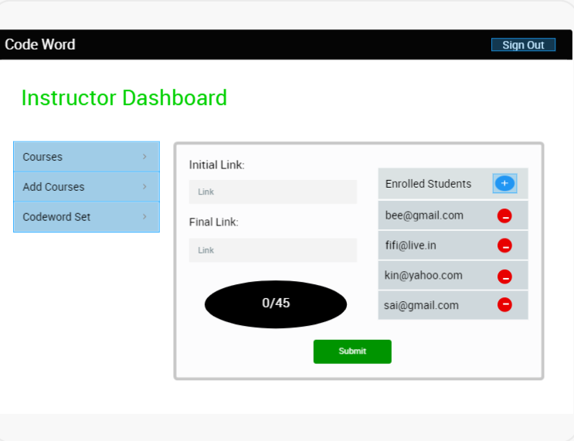
Swathi Challagundla

Slide 32
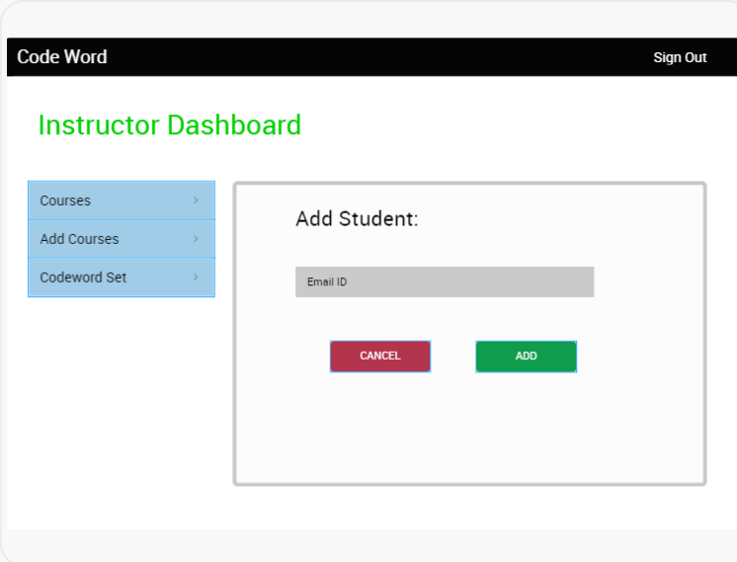
Swathi Challagundla

Slide 33
Instructor Functional Requirements
The system SHALL allow the instructor to create a code Word set.
The system SHALL allow adding a code word to codeword set.
The system SHALL allow deleting a code word from codeword set.
The system SHALL allow the instructor to Logout upon instructor Request.
Vamshi Krishna Nuka

Slide 34
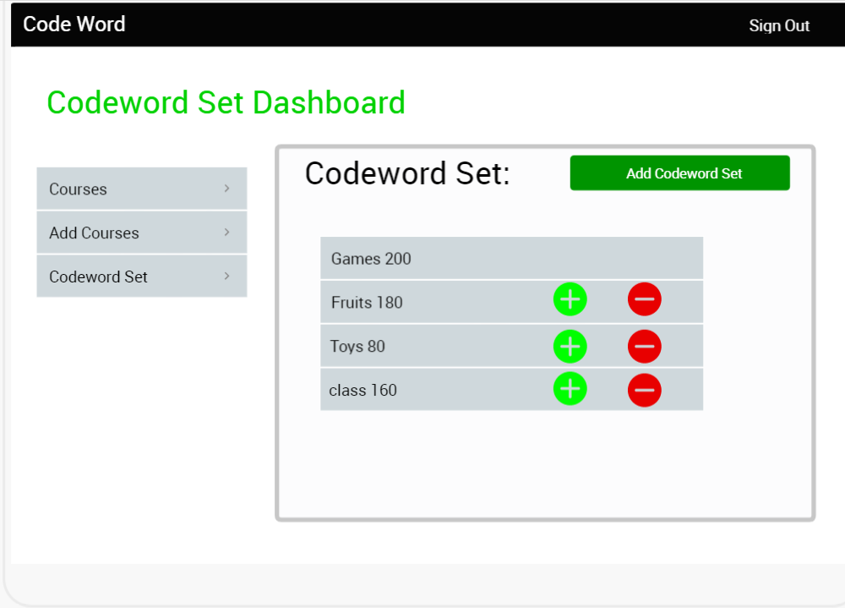
Vamshi Krishna Nuka

Slide 35
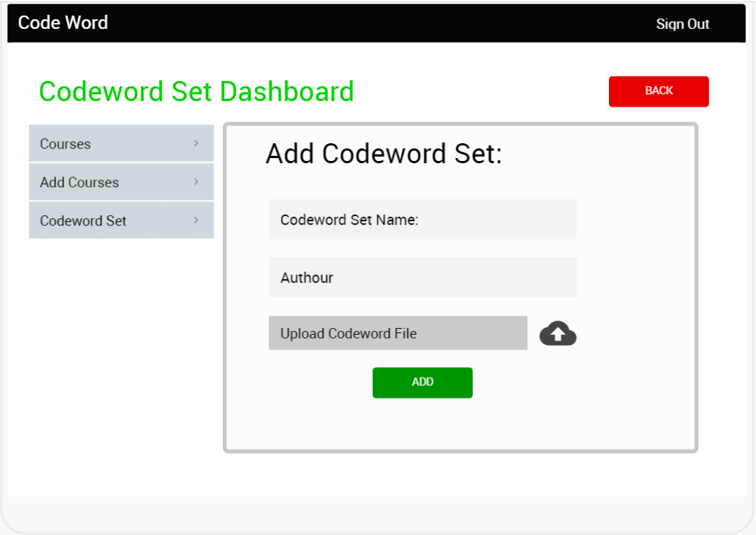
Vamshi Krishna Nuka

Slide 36
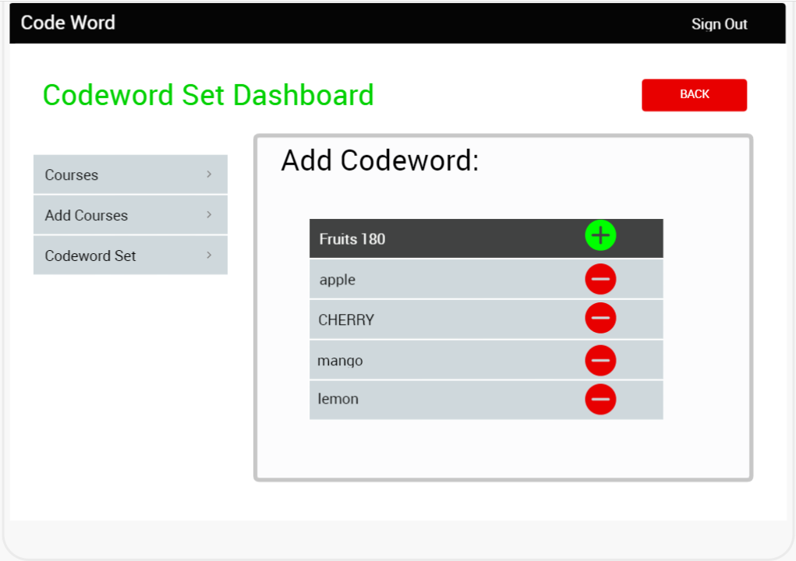
Vamshi Krishna Nuka

Slide 37
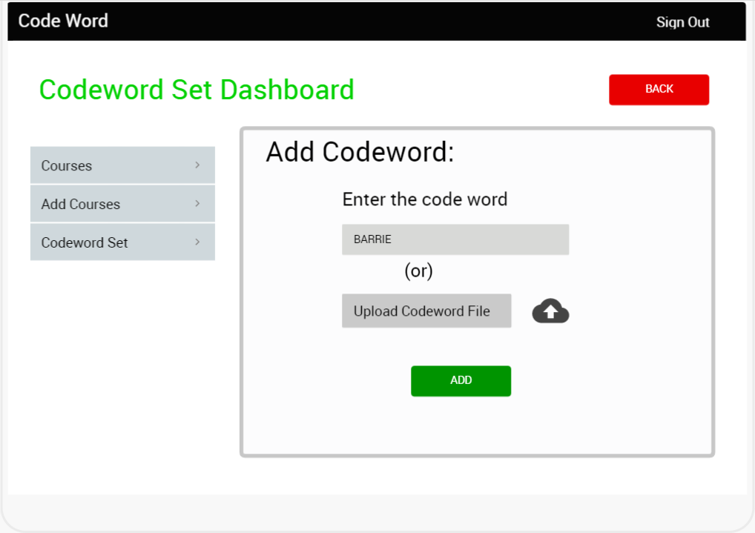
Vamshi Krishna Nuka

Slide 38
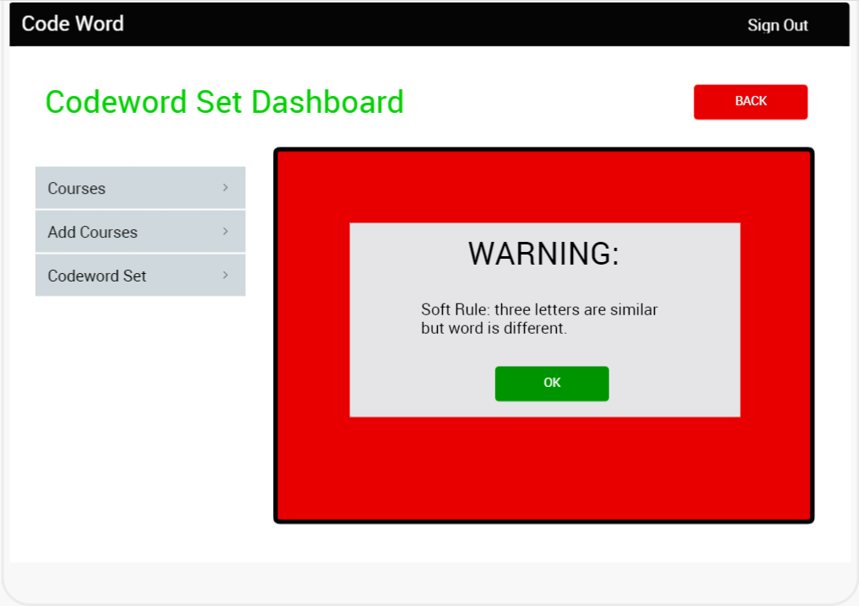
Vamshi Krishna Nuka

Slide 39
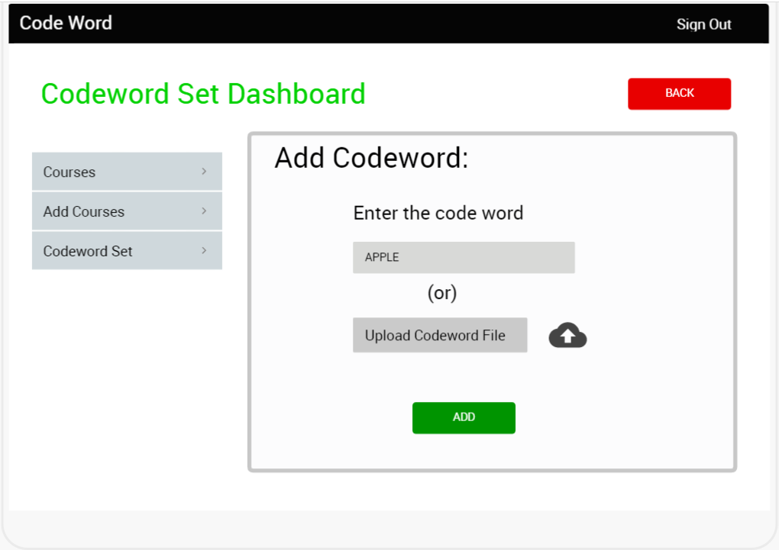
Vamshi Krishna Nuka

Slide 40
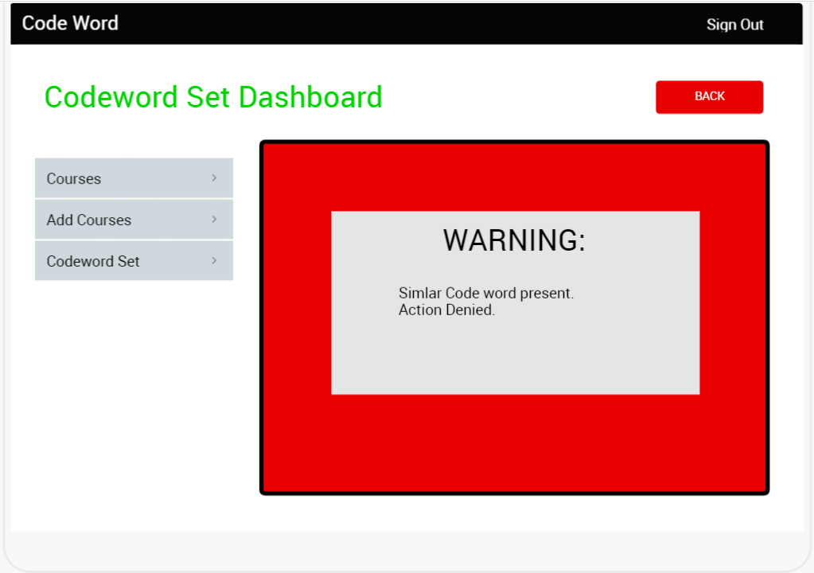
Vamshi Krishna Nuka

Slide 41
Admin Functional Requirements
The system SHALL allow admin to give instructor privileges to those requested for access.
The system SHALL allow admin to delete the instructor.
The system SHALL allow admin to add the codeword set.
The system SHALL allow admin to delete the codeword set.
Durga Prasad Vinukonda

Slide 42
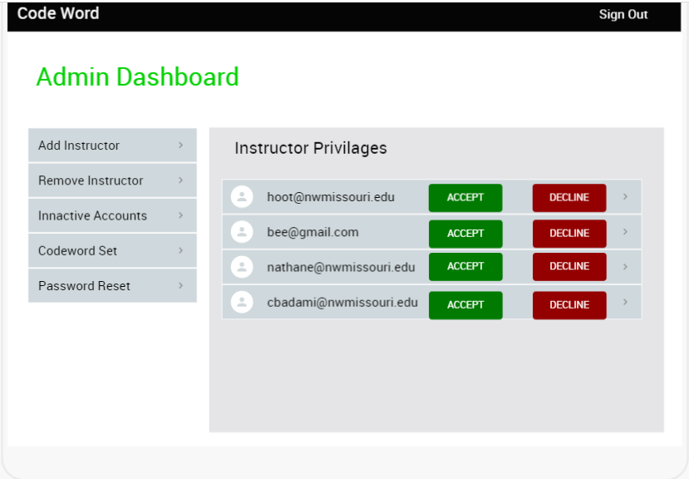
Durga Prasad Vinukonda

Slide 43
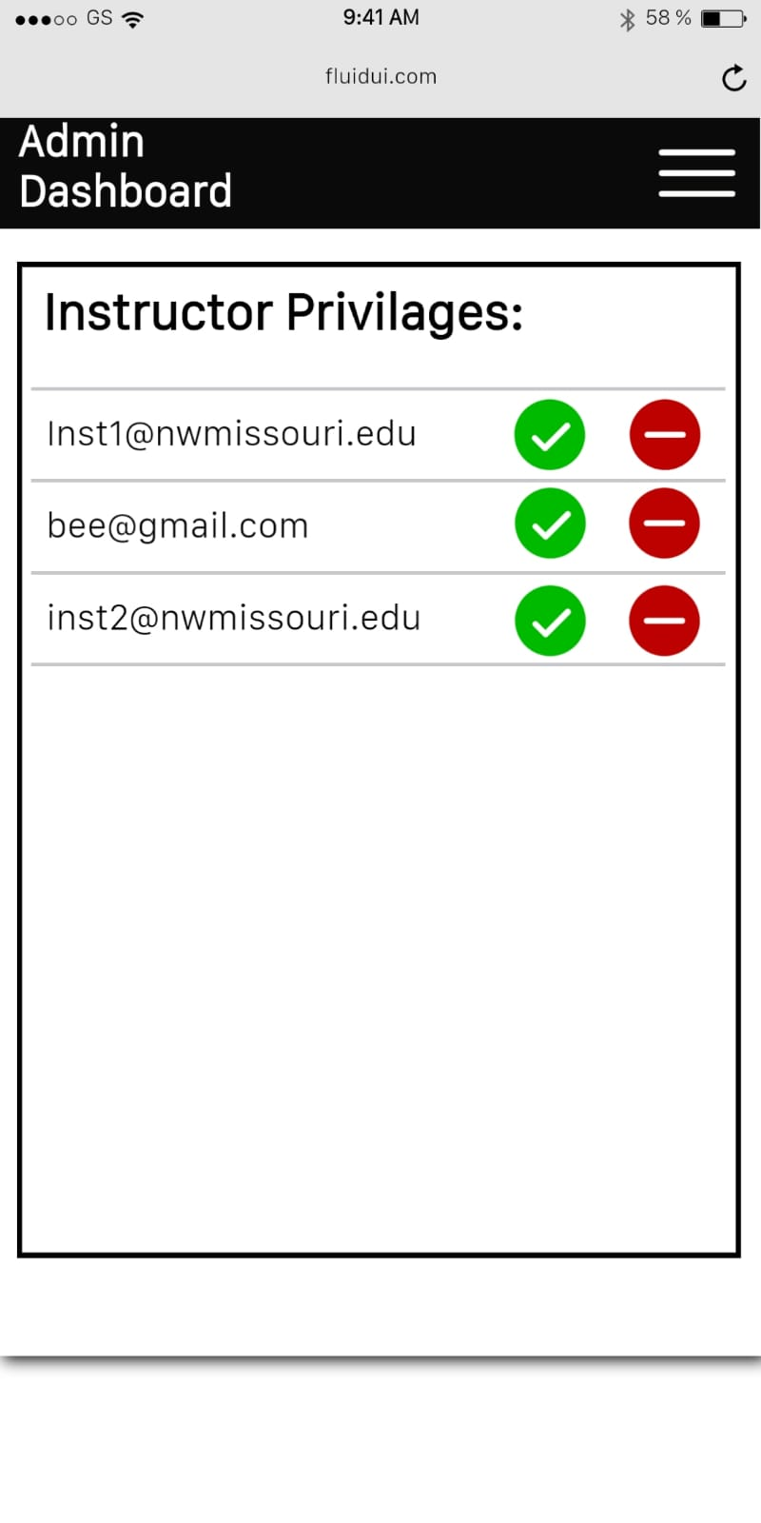
Durga Prasad Vinukonda

Slide 44
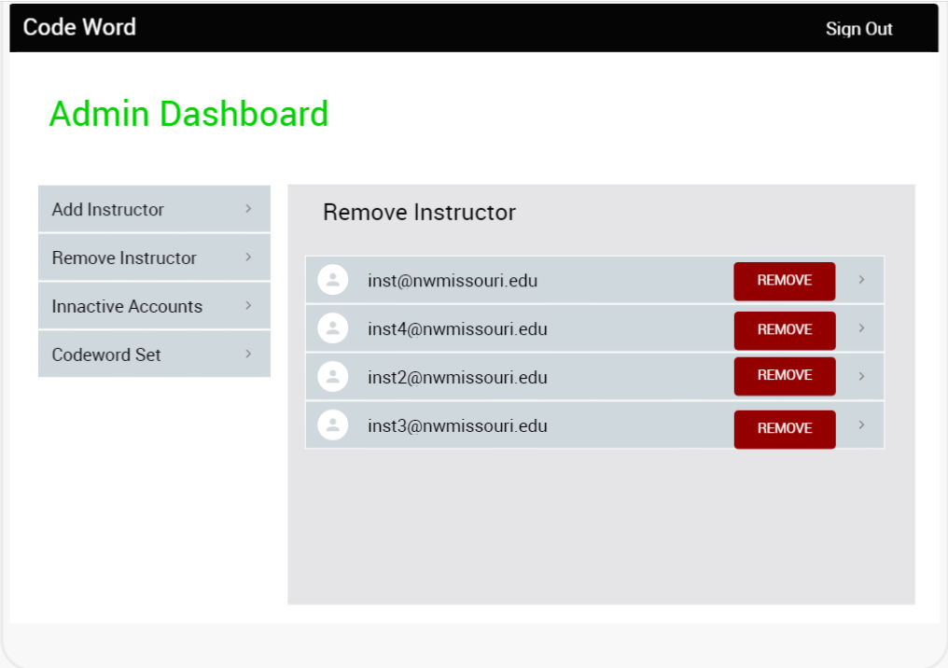
Durga Prasad Vinukonda

Slide 45
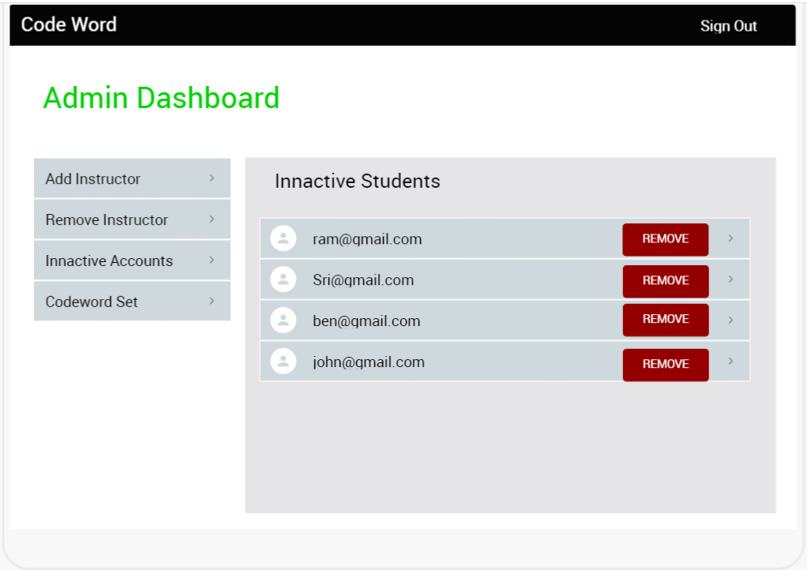
Durga Prasad Vinukonda

Slide 46
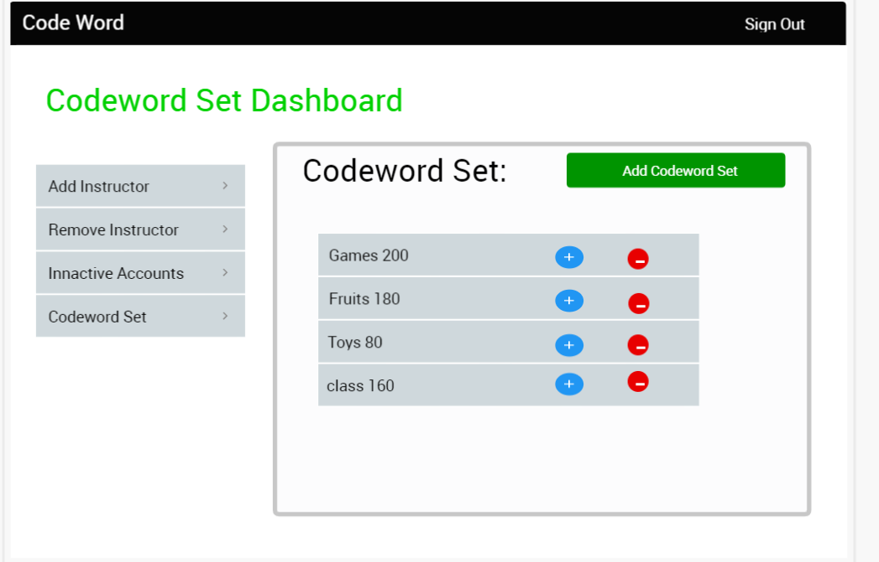
Durga Prasad Vinukonda

Slide 47
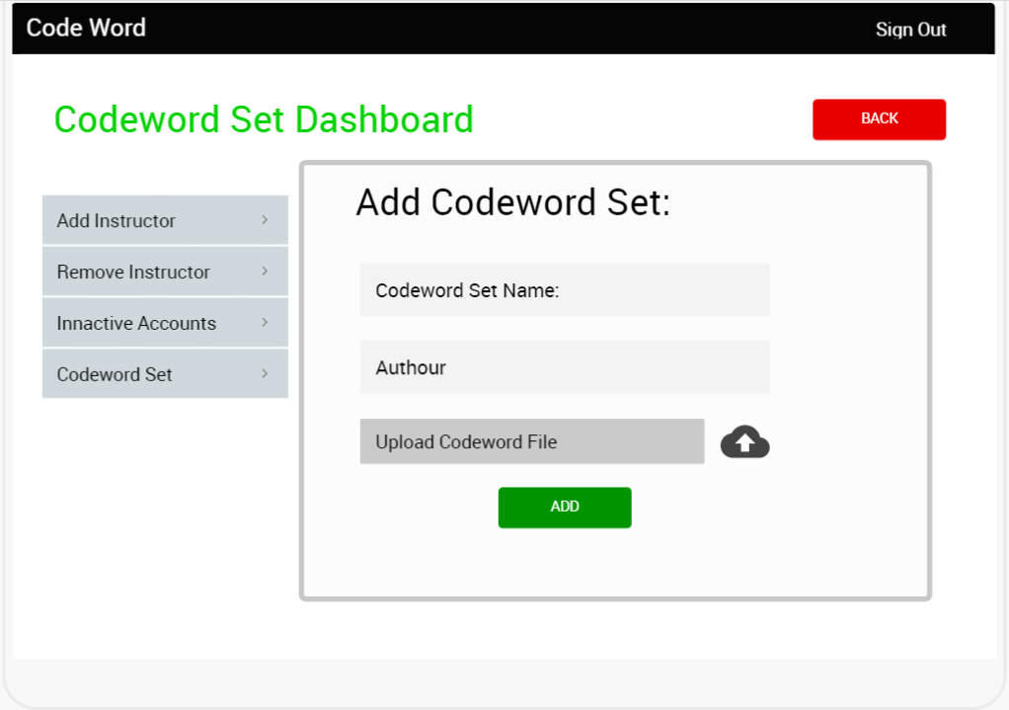
Durga Prasad Vinukonda

Slide 48
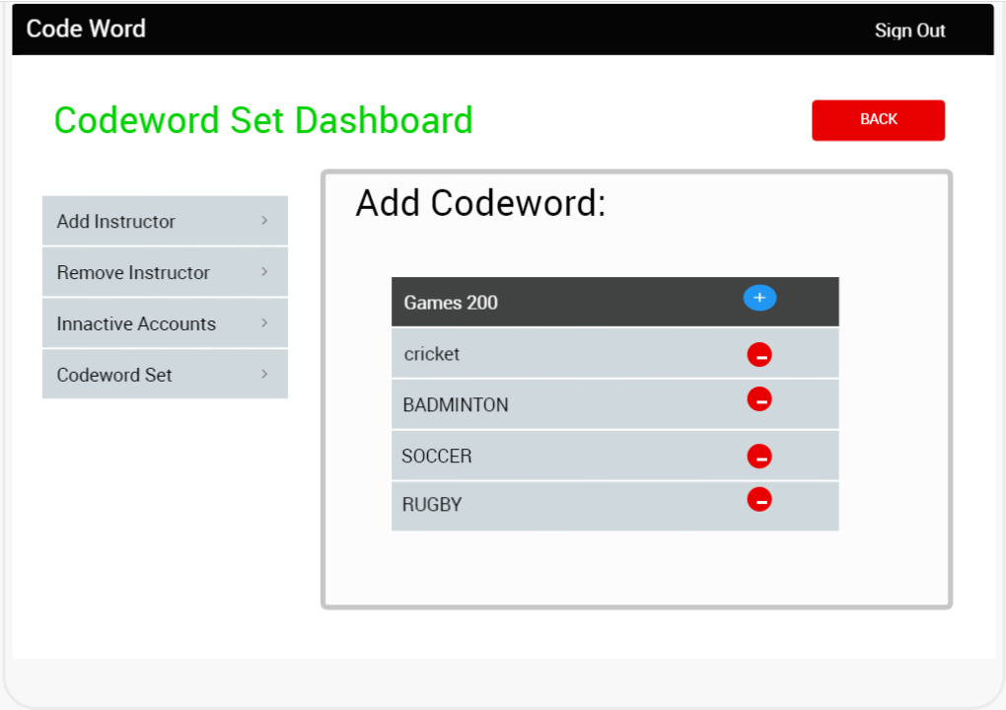
Durga Prasad Vinukonda

Slide 49
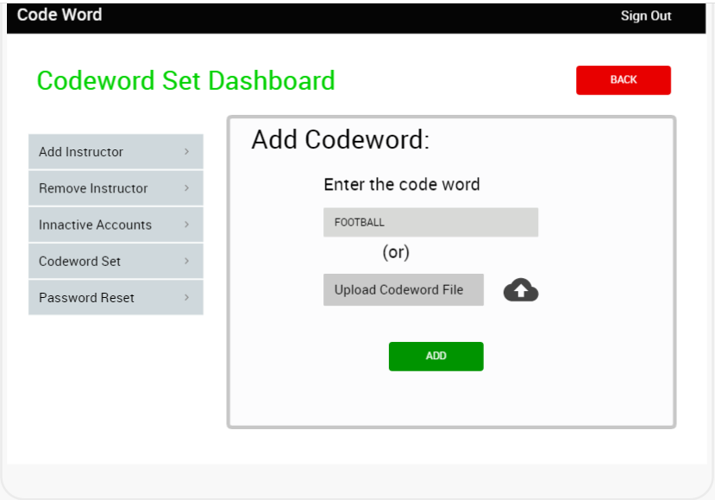
Durga Prasad Vinukonda

Slide 50
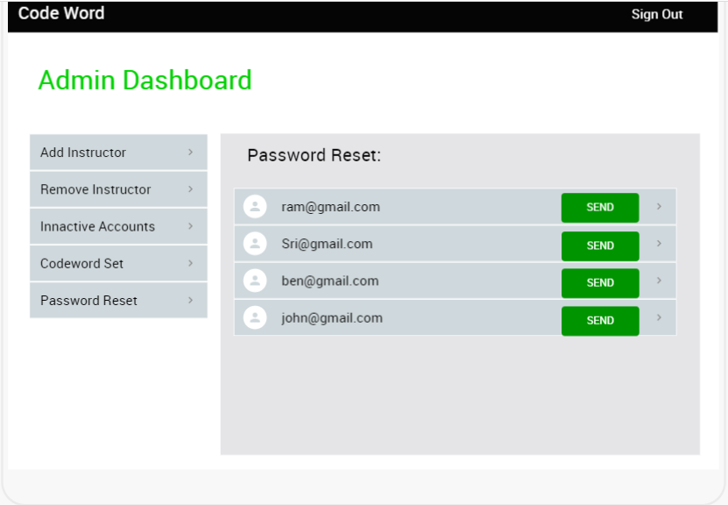
Durga Prasad Vinukonda

Slide 51
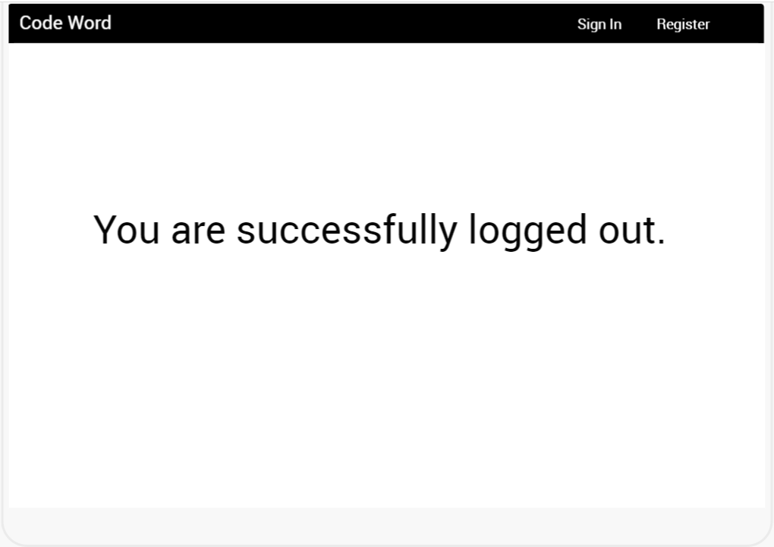
Durga Prasad Vinukonda

Slide 52


Mobile Prototype:
Durga Prasad Vinukonda

